Slide 1
FACILITIES DESIGN PROJECT
TU 601
May 13, 2010
Patt Angell
Janet Corbin
Debbie McCormack
Lizanne Wallace

Slide 2
for the LIBRARY at Wicomico Elementary School
Planning

Slide 3
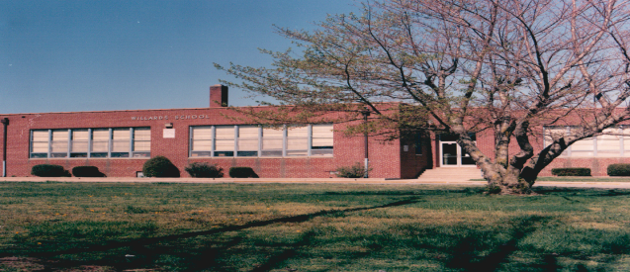
From the old…..
Willards Elementary

Slide 4
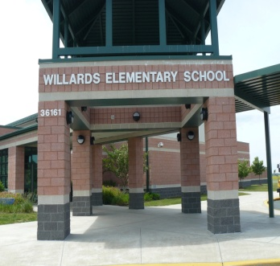
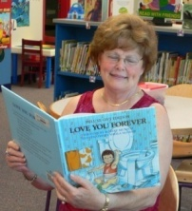
to the new….
2003

Slide 5
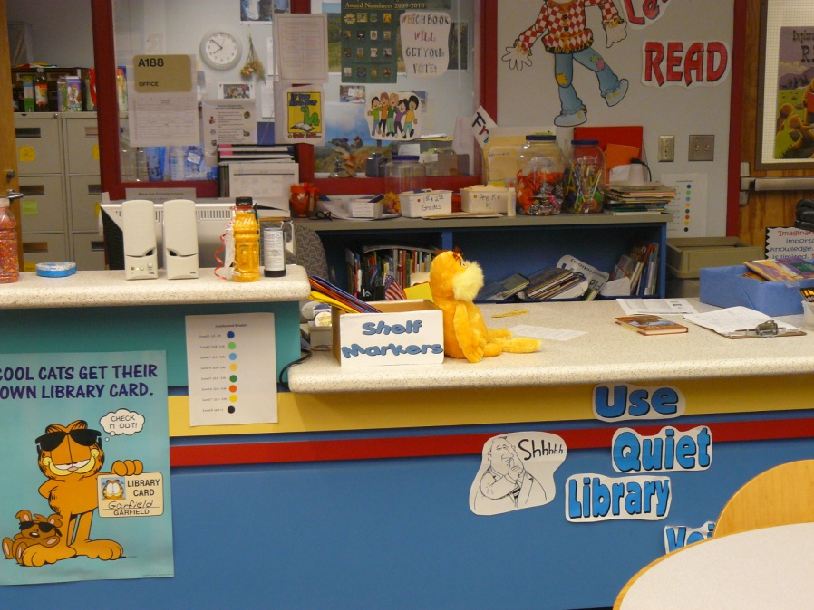
What Do We Like?
Round tables
Drop-down Circulation Desk

Slide 6
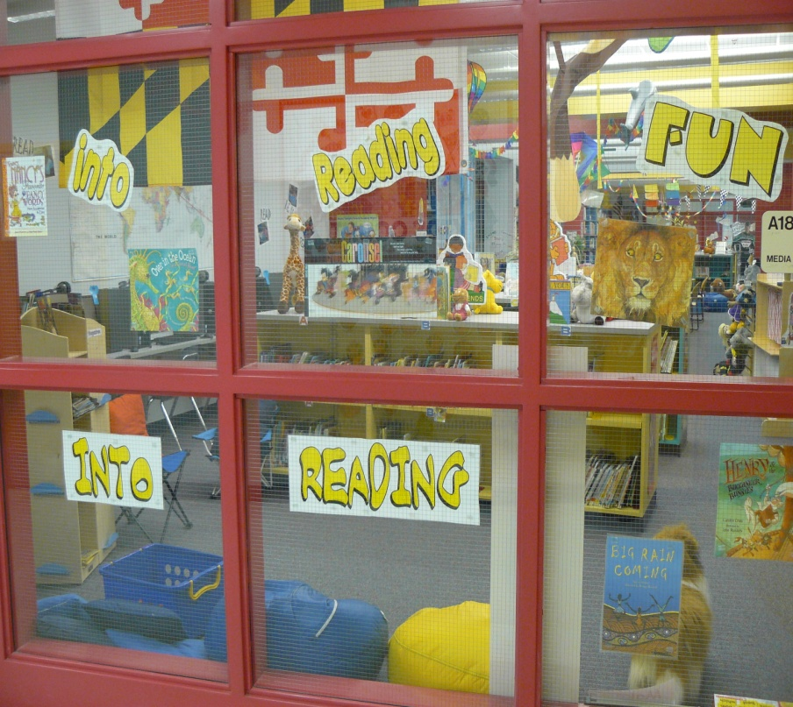
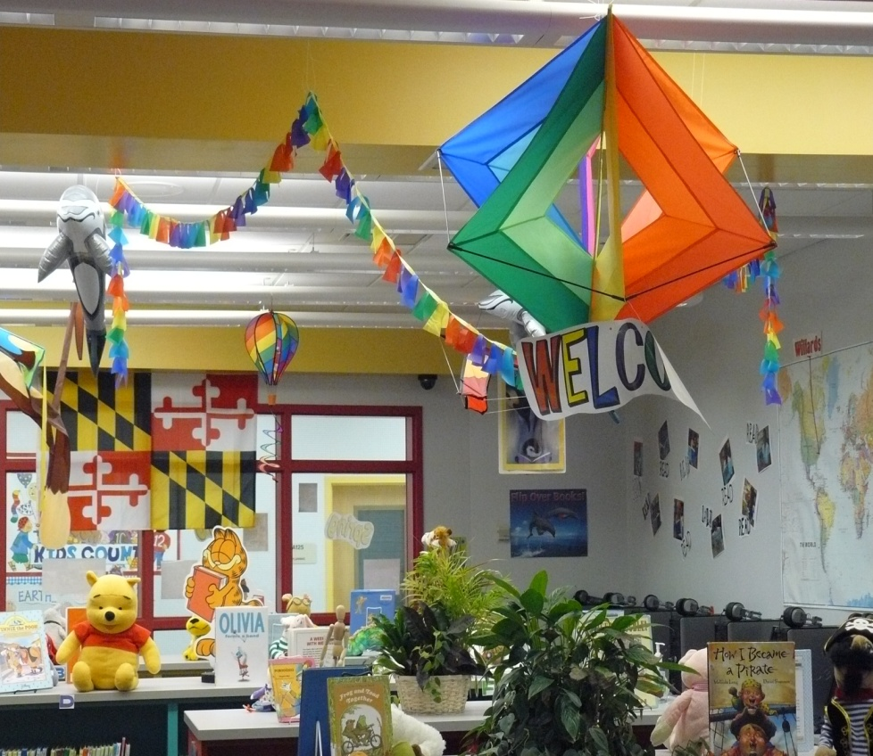
We like…
Bright Colors

Slide 7
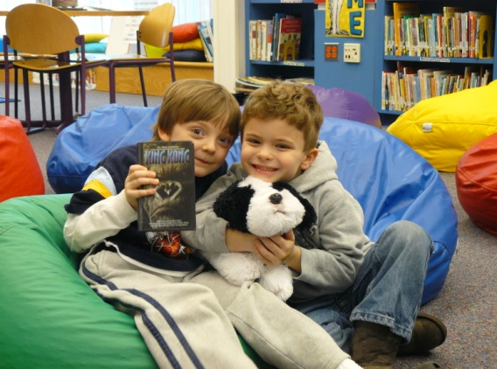
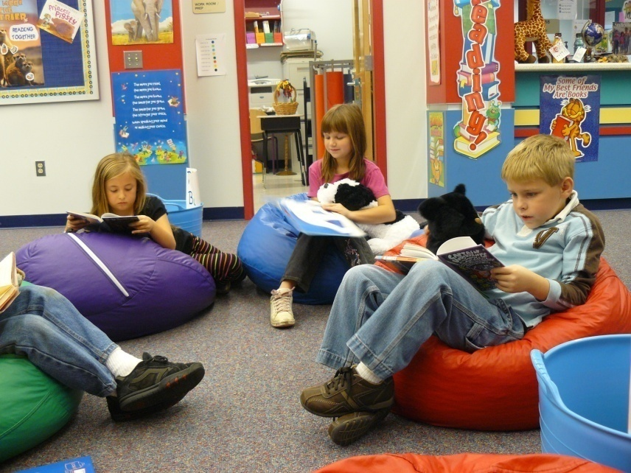
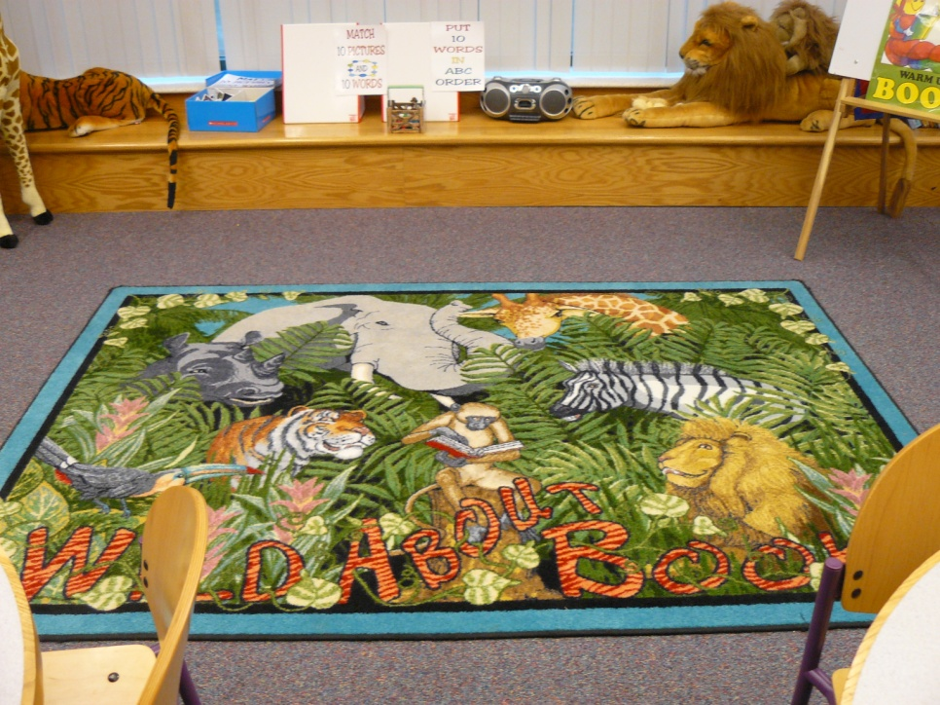
We like…
Kid size seats
Bean Bag Chairs
Story Time Carpets

Slide 8
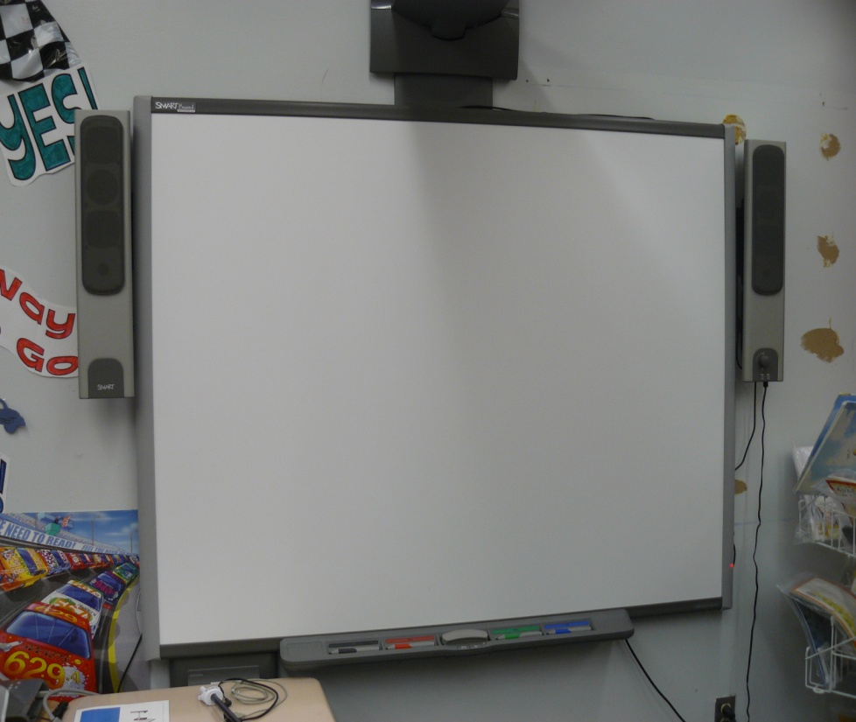
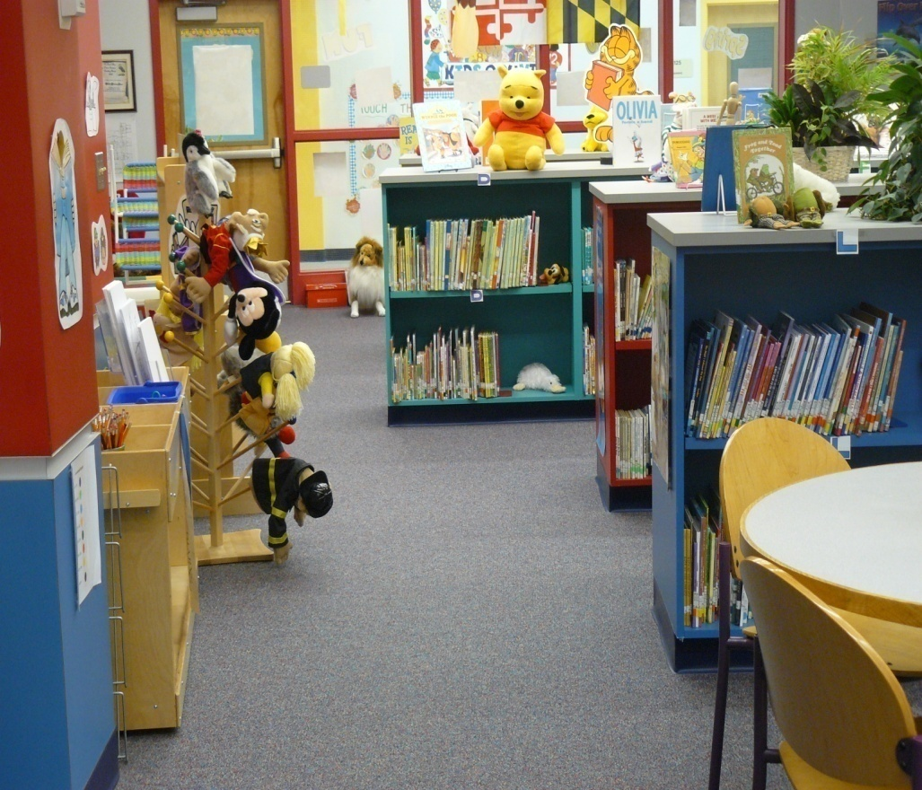
We like…
SMARTboards
Indoor/Outdoor Carpet

Slide 9
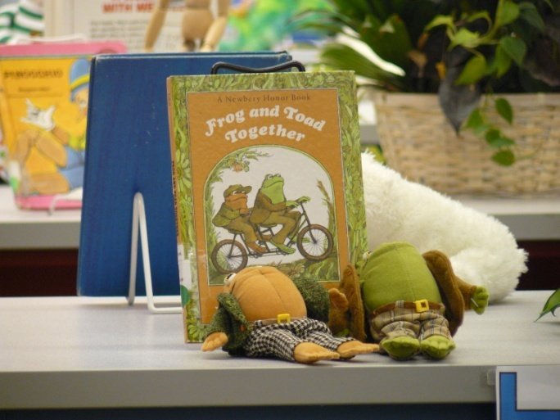
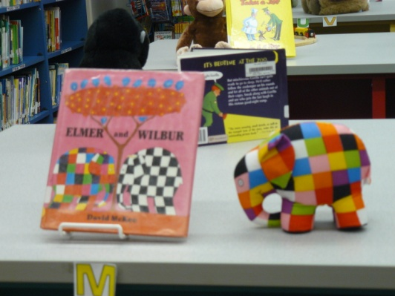
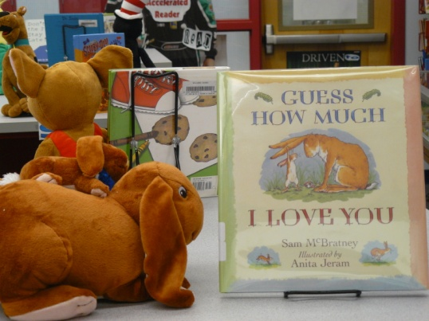
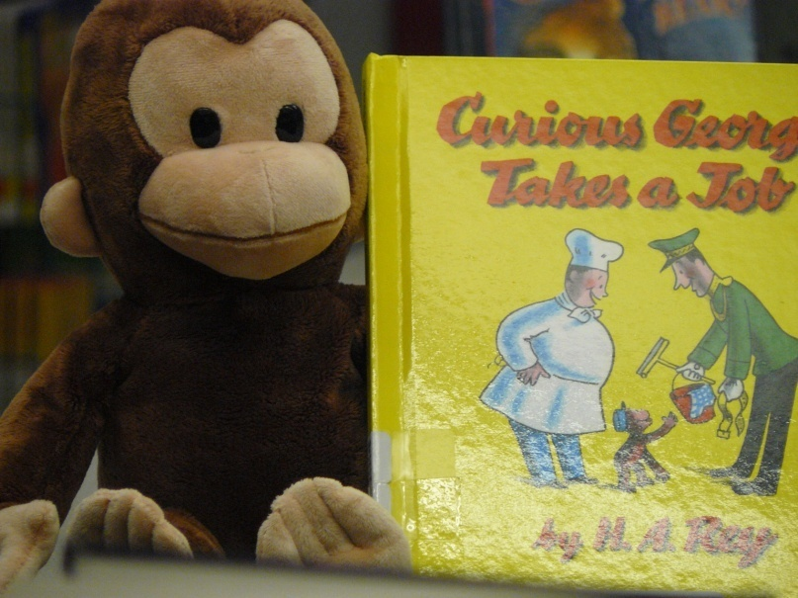
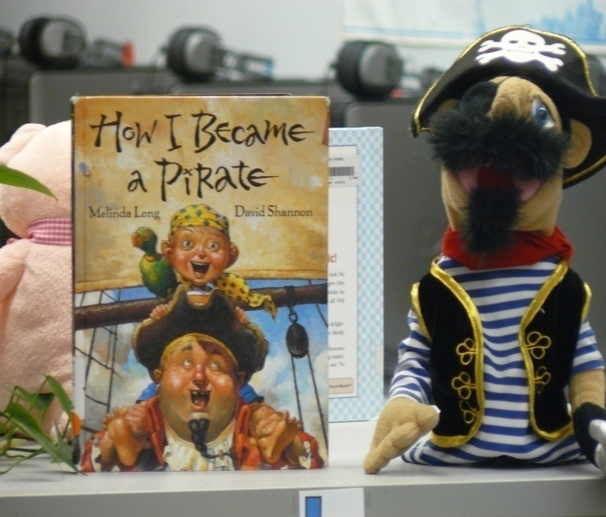
We like…
Shelf tops for displays

Slide 10
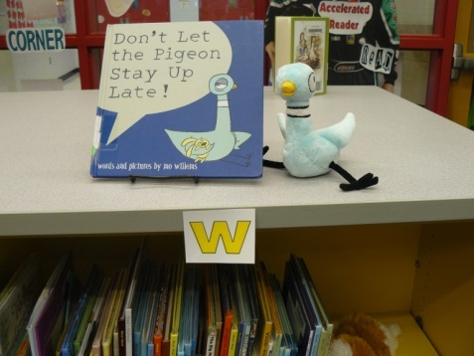
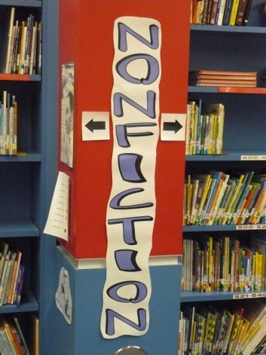
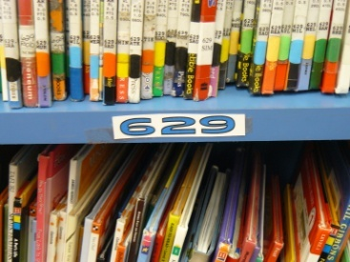
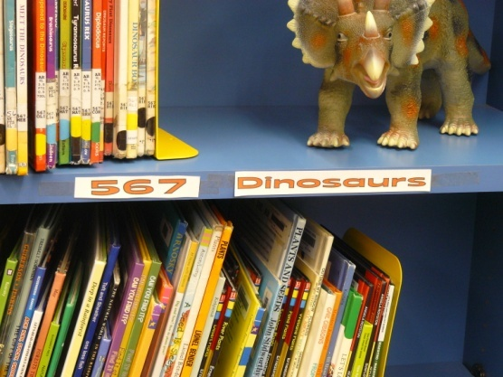
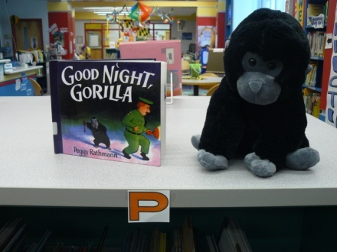
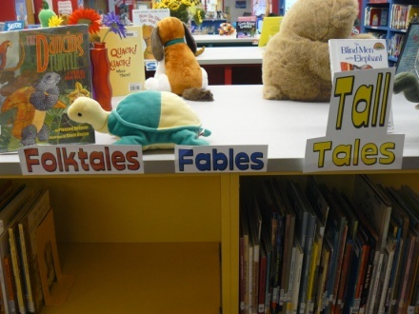
We like…
CLEAR
SIGNAGE

Slide 11
Facts
Wicomico Elementary School
Enrollment 500
Pre K – 5th grade
Plan…..needed spaces
Instruction
Reading
Book collections
Computer/Technology
Office

Slide 12
Wicomico Elementary School’s
original
LIBRARY

Slide 13
Floor Plan
New

Slide 14
Storage, Communications, and A/V Room

Slide 15
Quiet Reading Area
plants
tables

Slide 16
Circulation Desk

Slide 17
Computers

Slide 18
Table Area

Slide 19
Story Time

Slide 20
Book Collection

Slide 21
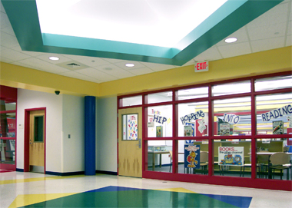
Educational Specifications
Tile Flooring:
Storage room
Communications
Studio
A/V
Computer area

Slide 22
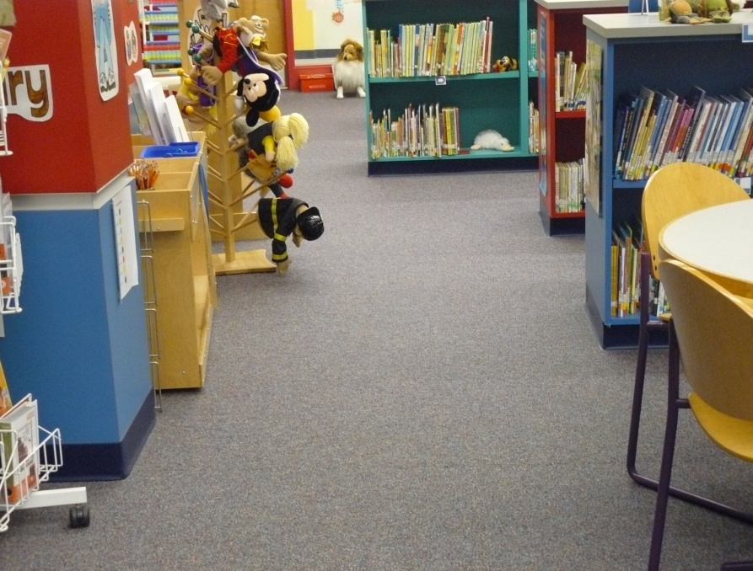
All other library areas are to have indoor/outdoor carpeting…
Carpet and Rug Institute Seal of Approval
Low levels of volatile compounds
Including the Media Specialist’s office.

Slide 23
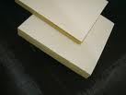
Ceiling
Acoustical tiles
Sound absorption

Slide 24
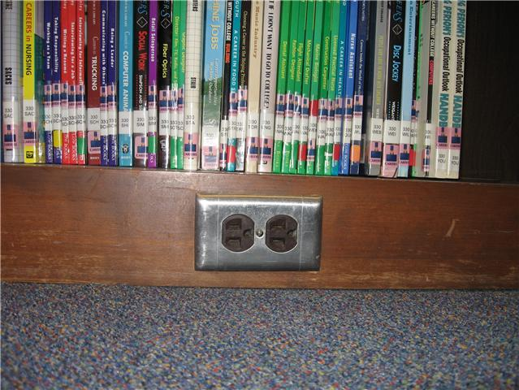
Power
every 3 feet under shelving
under each computer table
under circulation desk
Media Specialist’s office (every 3 feet)
under computer in instructional area
outlets

Slide 25
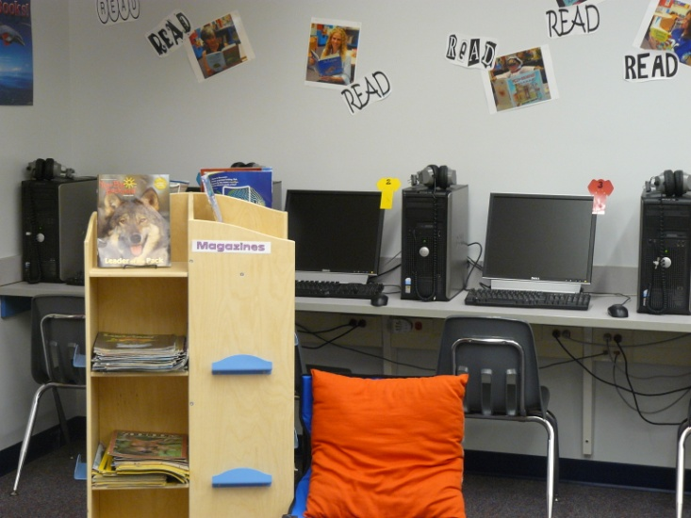
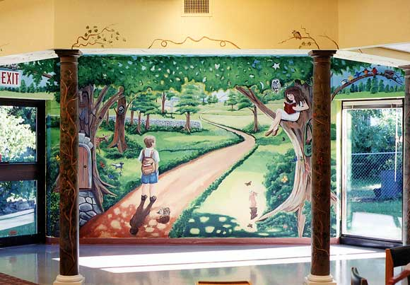
Walls & Decor
neutral paint
mural in casual reading area
nontoxic
fire retardant

Slide 26
Signage & Displays
End caps – Dewey numbers or Author’s last name
font – 48 pt. Century Gothic
Other signs used
Pictures in nonfiction

Slide 27
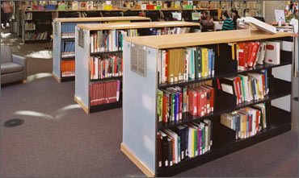
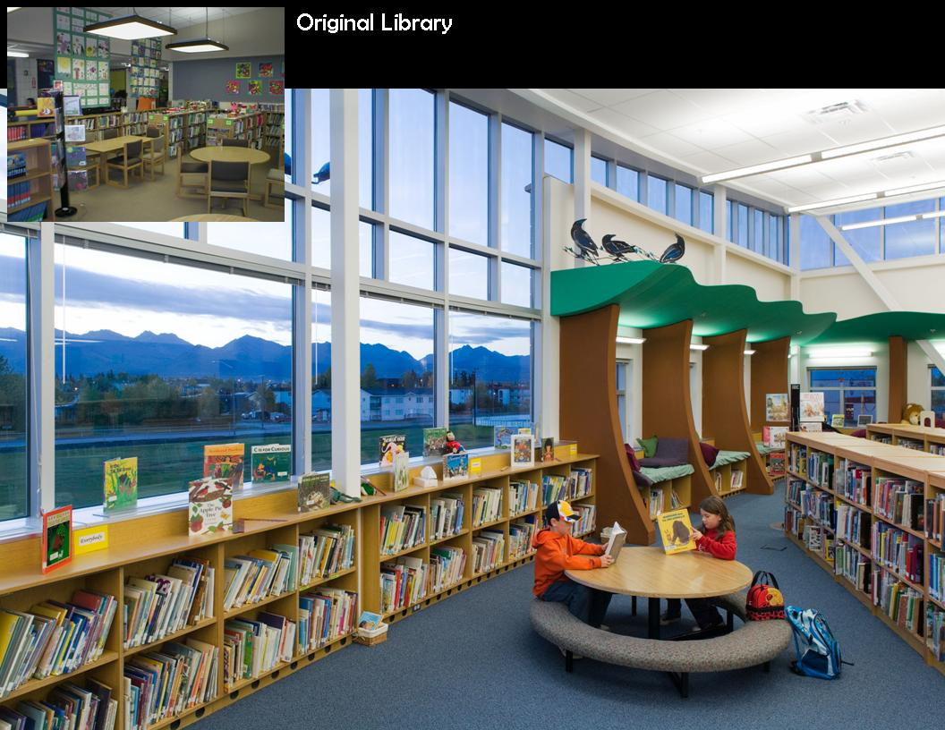
Shelving
wooden
tops and ends in primary colors
under windows – 36” high
main collection – 42” high
magazine rack – 60” high

Slide 28
Magazine Rack
60” tall
Tilted shelves

Slide 29
Outcomes and Responsibilities
Design encourages:
Curricular connections
Instruction
Research (w/ and w/o technology)
Silent Reading
Story times
Fulfillment of AASL Information Literacy Standards

Slide 30
Environmental Design Elements
Book Preservation
Heating and Air Conditioning
Controls located in MS’s office
Separate from school
70 – 77 degrees consistently
Ventilation System
Humidity constant 60%
Filters reduce mold, mildew, and air particulates

Slide 31
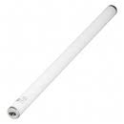
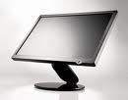
Lighting
Book stacks
parallel with linear fluorescent lamps
centered above each aisle
Computer area
indirect lighting
fluorescent ceiling fixtures
minimize glare

Slide 32
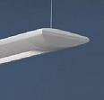
Lighting (continued)
Reading & Main
suspended fluorescent fixtures
up-light distribution – 80%
down-light distribution – 20%
T5 high output lamps
neutral color blending w/ daylight
low mercury content (safer disposal)
track lights for wall mural
Area

Slide 33
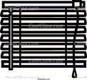
Lighting (continued)
MS’s office & Circulation Desk
table lamps
lights centrally controlled
one switch on wall at entrance to activate entry lights
Outside Light
horizontal blinds on all windows
remote
controlled

Slide 34
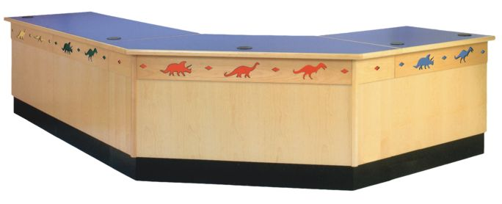
Special Learners
ACCOMMADATIONS
Bookshelf aisles – 4 feet wide
Bookshelf height
Circulation Desk 36” high
All tables appropriate height

Slide 35
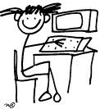
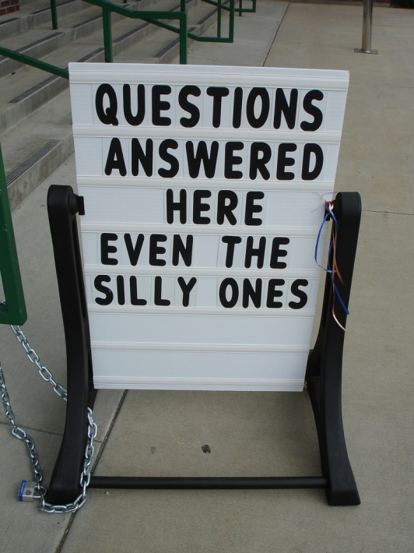
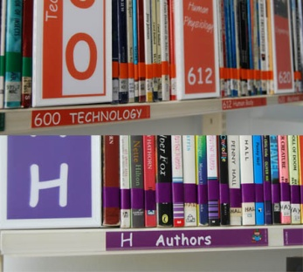
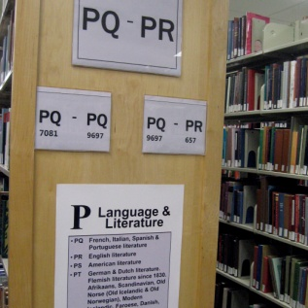
Special Learners (continued)
ACCOMMADATIONS
Computer adaptations
Voice activated
Zoom font
Large keyboard
Signage
Clarity
Braille

Slide 36
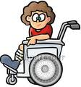
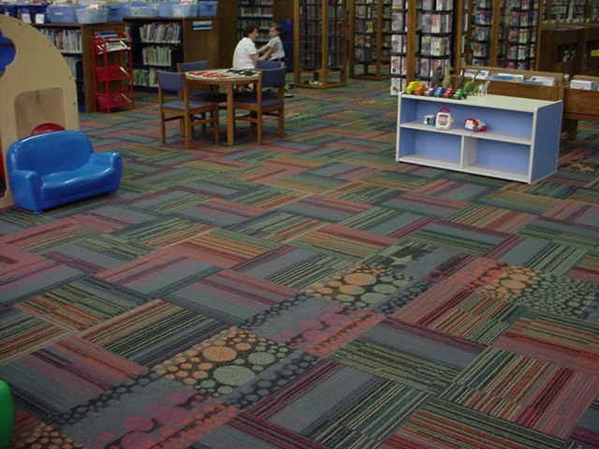
Special Learners (continued)
ACCOMMADATIONS
Entrance Switch
Indoor/Outdoor Carpet

Slide 37
Relocation
And moving plans

Slide 38
Relocation
June 9
And moving plans

Slide 39
STANDARDS
AASL Information Literacy Standards for Student Learning
AASL 21st Century Learner Standards
Maryland VSC - Media

Slide 40
AASL Information Literacy Standards for Student Learning
Information Literacy
Standard 1: The student who is information literate accesses information efficiently and effectively.
Indicator 1: Recognizes the need for information. (Computer, reference and instructional areas)
Indicator 4: Identifies a variety of potential sources of information. (Computer, research and areas.)
Indicator 5: Develops and uses successful strategies for locating information. (Computers, reference, non-fiction)
Standard 2: The student who is information literate evaluates information critically and competently.
Indicator 1: Determines accuracy, relevance, and comprehensiveness. (Computers, non-fiction, reference.)
Indicator 4: Selects information appropriate to the problem or question at hand. (Computers, non-fiction, reference)
Standard 3: The student who is information literate uses information accurately and creatively.
Indicator 2: Integrate new information into one’s own knowledge.(Non-fiction, Computers)

Slide 41
AASL Information Literacy Standards for Student Learning
Independent Learning Standards
Standard 4: The student who is an independent learner is information literate and pursues information related to personal interests.
Indicator 1: Seeks information related to various dimensions of personal well-being, such as career interest, community involvement, health matters and recreational pursuits.(Non-fiction, fiction.)
Indicator 2: Designs, develops, and evaluates information products and solutions related to personal interests. (Non-fiction, fiction)
Standard 5: The student who is an independent learner is information literate and appreciates literature and other creative expressions of information.
Indicator 1: Is a competent and self-motivated reader. (Fiction, Non-fiction, casual reading area)
Standard 6: The student who is an independent learner is information literate and strives for excellence in information seeking and knowledge generation.
Indicator 2: Devises strategies for revising, improving, and updating self-generated knowledge. (Fiction, Non-fiction, casual reading)

Slide 42
AASL Information Literacy Standards for Student Learning
Social Responsibility Standards
Standard 7: The student who contributes positively to the learning community and to society is information literate and recognizes the importance of information to a democratic society.
Indicator 1: Seeks information from diverse sources, contexts, disciplines and cultures. (Fiction, non-fiction, computers)
Standard 8: The student who contributes positively to the learning community and to society is information literate and practices ethical behavior in regard to information and information technology.
Indicator 3: Uses information technology responsibility. (Computers)
Standard 9: The student who contributes positively to the learning community and to society is information literate and participates effectively in groups to pursue and generate information.
Indicator 1: Shares knowledge and information with others. (Casual reading area, instructional tables, computers)

Slide 43
AASL 21st Century Learner Standards
Standard 1: Inquire, think critically and gain knowledge. (Computers, instructional area, casual reading area, fiction and non-fiction)
Standard 2: Draw conclusions, make decisions, apply knowledge to new situations, and create new knowledge. (Computers, instructional area, reference, non-fiction)
Standard 3: Share knowledge and participate ethically and productively as members of our democratic society. (Instructional area, casual reading area, computers)
Standard 4: Pursue personal and aesthetic growth. (Fiction, non-fiction, casual reading area, computers)

Slide 44
Maryland VSC – Media
1.0 Literature Appreciation: Students will demonstrate an appreciation of literature as a reflection of human experience and reading as a pleasurable activity. (Fiction, non-fiction,casual reading area)
2.0 Locate Information: Students will be able to use resources, in a wide variety of formats, to locate information to meet an identified need. (Computers, reference, non-fiction)
3.0 Collect Information: Students will be able to collect information relevant to their current information need. (Computers, reference, non-fiction, fiction)
4.0 Organize and Manage Data/information: Students will use appropriate print, non-print and computer/online/digital formats to organize and manage data/information. (Computers, non-fiction)
5.0 Interpret Information: Students will be able to interpret information to generate new
understandings and knowledge. (Fiction, casual reading areas)
6.0 Share Findings/Conclusions: Students will be able to communicate findings/conclusions by producing materials in an appropriate format to support written, oral and multi-media presentations. (Computers, communications room)
7.0 Ethical Use of Information: Students will demonstrate responsible attitudes toward the use of information. (Computers, reference, instructional area)

Slide 45
Bibliography
Association of School Librarians. (1998). Information power: building partnerships
American for learning. Chicago, IL: American Library Association.
American Association of School Librarians. (2006). Standards for the 21st-century learner.
Retrieved April 20, 2010 from http://www.ala.org/ala/mgrps/divs/aasl/
guidelinesandstandards/learningstandards/standards.cfm doi: 248674
American Library Association. (2009, January 28). ALA / ISLMA information literacy standards
for student learning. Retrieved May 1, 2010 from http://21cif.com/resources/ materials/
survey/standards/alastandards.htm
Becker Morgan Group (Photographer). (2010). Willards Elementary School Media Center
[Images of library]. Willards, Maryland; Willards Elementary School. Retrieved April 19,
2010 from http://www.beckermorgan.com/projects/dspProjectDetail.
cfm?sector=3&project=35&sub=16
Bering, Wendy (Artist). Pelham public library mural. [Image of mural]. Pelham, New York;
Pelham Public Library. Retrieved May 1, 2010 from http://www.naturepaintings.com/
murals/Library.htm

Slide 46
Bibliography (continued)
Clip Art. Retrieved April 25, 2010, from http://office.microsoft.com/en-
us/clipart/results.aspx?qu=paper&sc=20
DeKalb County School System. (2003 - 2009). School library media lighting. [Image of lights]. Retrieved April 25, 2010 from http://www.dekalb.k12.ga.us/progress/projects/hvac/
Elk Grove Village Public Library, (2005). New library rug in youth services [Image of rug].
Retrieved April 26, 2010 from http://blogs.northstarnet.org/egvpl/archives/2005/05/
Graham, C. and Demmers, L. (2001). Furniture for libraries. Retrieved April 27, 2010 from
http://librisdesign.org/docs/FurnitureLibraries.pdf
Hurst-Wahl, J. (2007). Library signage [Image of sign]. Retrieved from http://sla-
divisions.typepad.com/itbloggingsection/2007/09/five-uses-of-fl.html
Lamb, A. and Johnson, L. (2004-2007). The School library media specialist. Retrieved April 28,
2010 from http://eduscapes.com/sms/index.html
Malman, D. (2001). Lighting for libraries. Retrieved April 30, 2010 from http://librisdesign.
org/docs/LightingLibraries.pdf
Maryland State Department of Education. (2000). Standards for school library media programs
in maryland. Retrieved May 1, 2010 from http://www.marylandpublicschools.org/NR/
rdonlyres/EC67FB12-FE6B-464A-A2AD-D0C6307773E3/13092/SLMStandards.pdf

