Slide 1
Parkside High School and Willards Elementary Literacy Program
March 31, 2011

Slide 2
Welcome!

Slide 3
Matt Layfield

Slide 4
Anna Davis

Slide 5
Damian Williams

Slide 6
Breck Sullivan

Slide 7
Frank Marshall

Slide 8
Mrs. Roberts’ 2nd Grade Class

Slide 9
Mrs. Webb’s Kindergarten Class

Slide 10
Mrs. Simpkins 2nd Grade Class

Slide 11
Anna

Slide 13
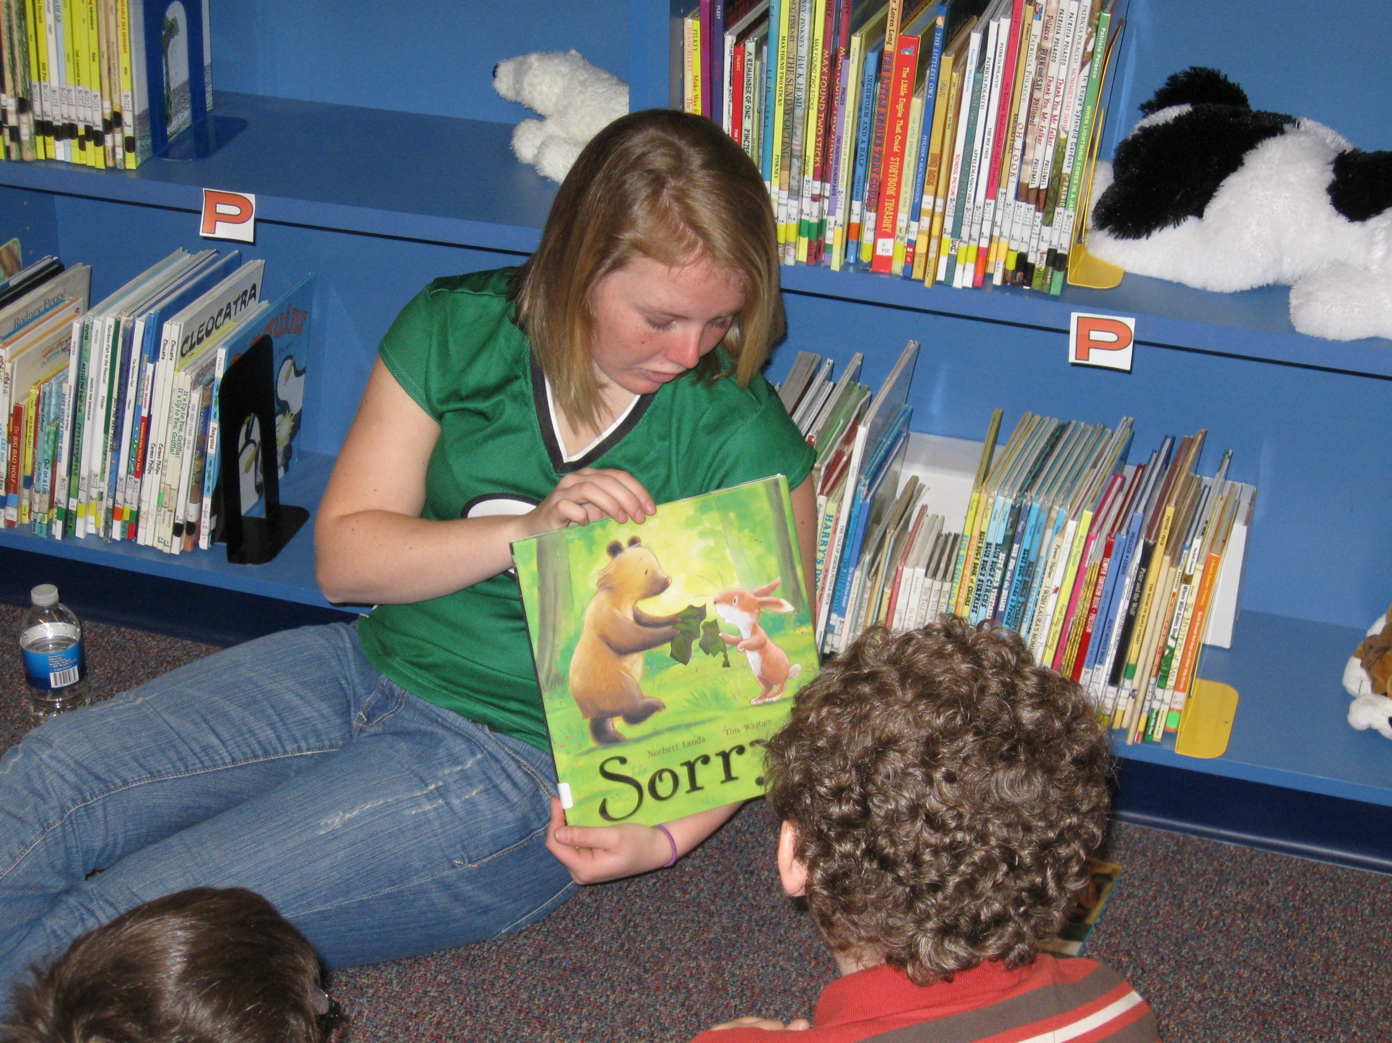

Slide 15
Matt

Slide 17
Go PARKSIDE!!!

Slide 18
Great Job Damian, Anna, Matt, Breck and Frank!!! ☺

